Slide 1

CNN Architectures
LeNet
AlexNet
VGG
GoogLeNet
ResNet

Slide 2
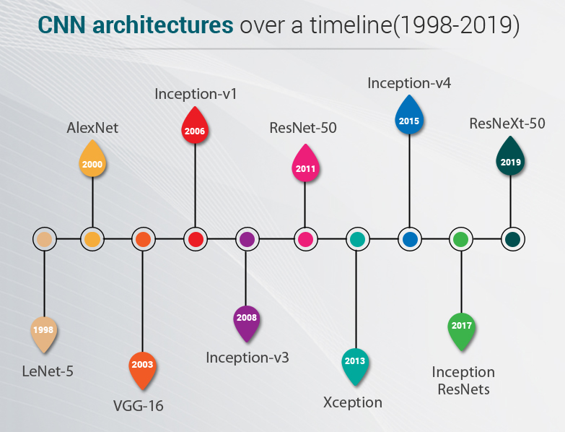
Different CNN Architectures
No: of Layers :How many convolutional, max pooling fully connected layers?
No: of Filters in each layer
Filter Size
Max pooling: What arrangement? 2 convolutional and then maxpooling or alternate convolutional and maxpooling?
Use standard tried and tested
architectures!

Slide 3
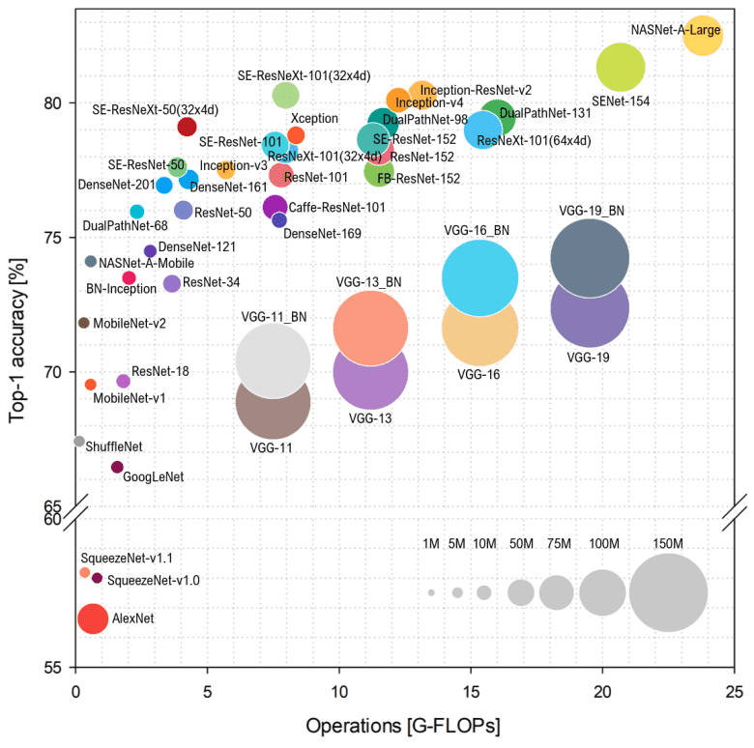
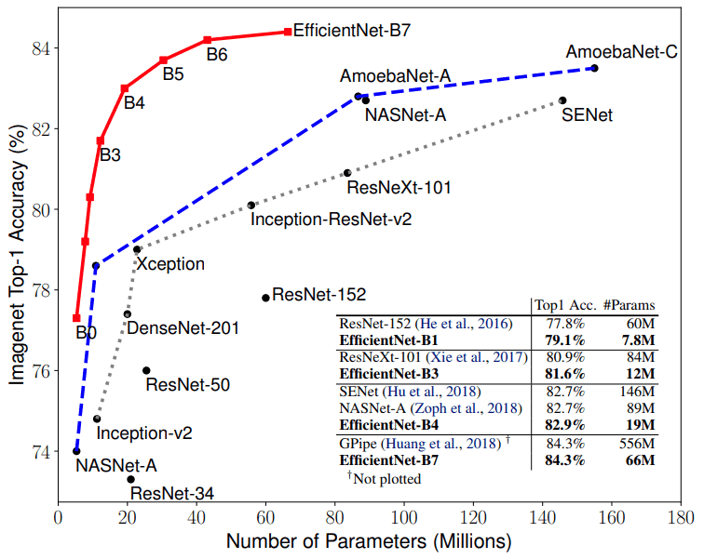
Gigaflops is a unit of measurement used to measure the performance of a computer's floating-point unit, commonly referred to as the FPU
. One gigaflops is one billion (1,000,000,000) FLOPS, or floating-point operations, per second.

Slide 4
CNN Architecture
LeNet

Slide 5
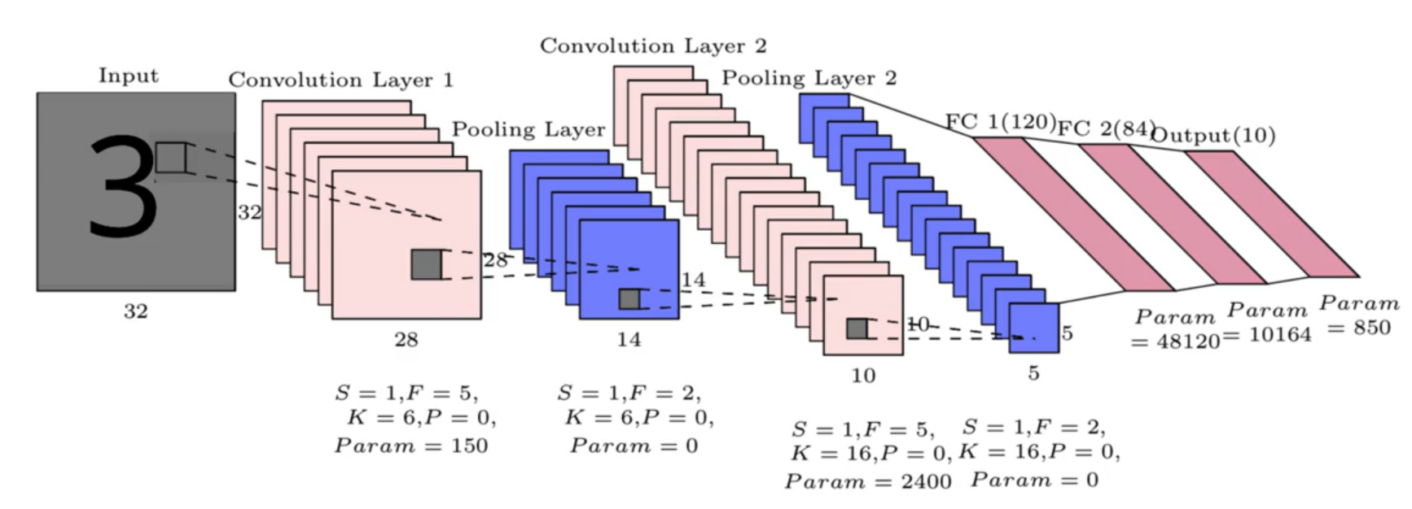
LeNet-5 – First CNN Architecture
Earliest pre-trained models proposed by Yann LeCun and others in the year 1998, in the research paper Gradient-Based Learning Applied to Document Recognition. They used this architecture for recognizing the handwritten and machine-printed characters.
6x5x5=150
Depth of filter is always depth of the input
5x5x6x16=2400
After each convolution there is non-linearity applied using activation functions- Relu/Leaky Relu. h1=g(a1)

Slide 6


Calculation of no of parameters
LeNet-5 – First CNN Architecture
FC1
Flatten 5x5x16=400 neurons
Hidden layer size=120
Bias from each node comes to 120
Parameters = 400x120+120=48120
Conv Layer 2
Conv Layer 1
S=1,F=5,K=6
W0=(32+0-5)/1+1=28,
As no of filters 6 we get 6 outputs of 28x28 ( Filter size 5x5)
No: of parameters= 5x5x6=150
[Comparing with fully connected
Flatten 32x32
Flatten 28x28x6
Total parameters = 32x32x28x28x6]
S=1,F=5,K=16
W0=(14+0-5)/1+1=10,
As no of filters 16 we get 16 outputs of 10x10 from 6 input images( Filter size 5x5)
No: of parameters= 5x5x6x16=2400
[Comparing with fully connected
14x14x6x10x10x16]
FC2
Hidden layer 1 size= 120
Hidden layer2 size =84
Bias from each of 84 hidden layer neuron=84
No of parameters= 120x84+84=10164
FC3
Hidden layer 1 size= 84
Hidden layer2 size =10
Bias from each of 10 hidden layer neuron=10
No of parameters= 84x10=850

Slide 7
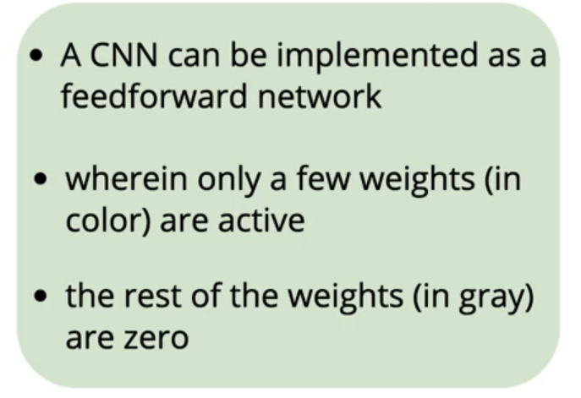
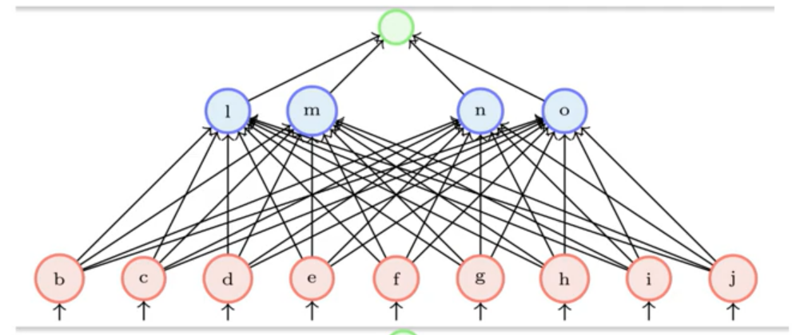
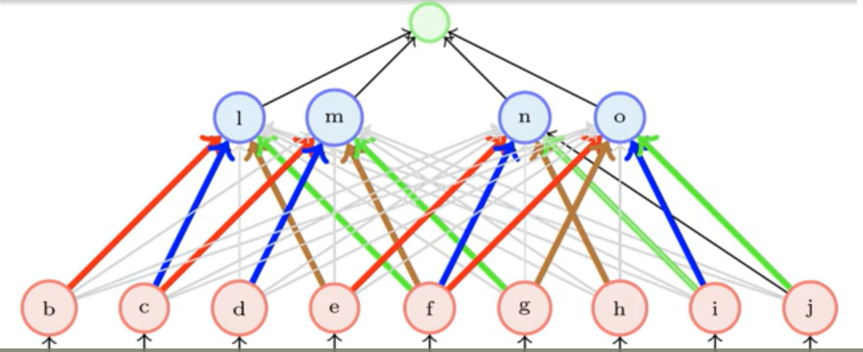
How to train a Convolutional Neural Network
Deep learning frameworks have optimized codes which does not have to do the zero weight calculations or storage

Slide 8

AlexNet

Slide 9
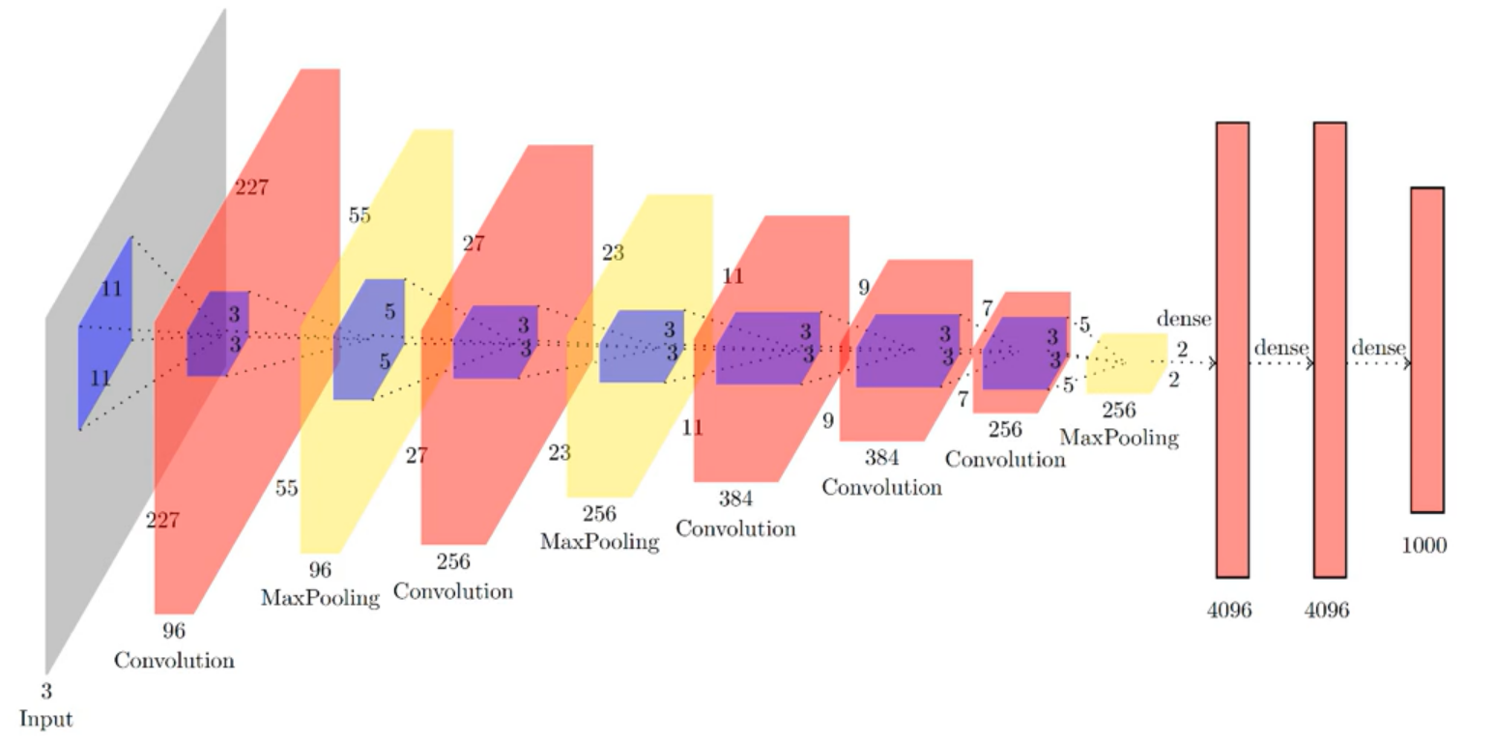
AlexNet is the name of a convolutional neural network (CNN) architecture, designed by Alex Krizhevsky in collaboration with Ilya Sutskever and Geoffrey Hinton, who was Krizhevsky's Ph.D. advisor in the year2000
ALexNet (8 layers)
3.55 M
4M
16M
4M
Layer5
Layer4
Layer3
Layer8
Layer2
Layer7
Layer6
Layer1
Depth of filter is always depth of the input

Slide 10
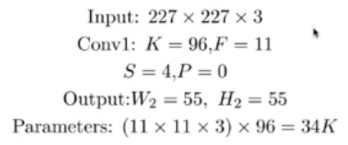
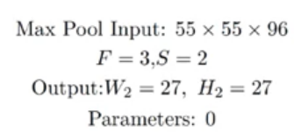
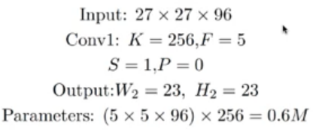
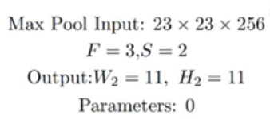
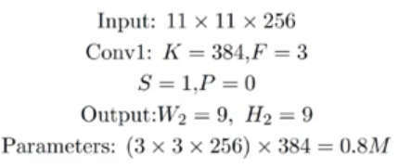
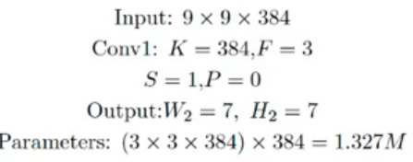
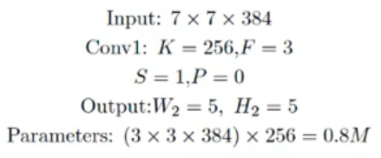
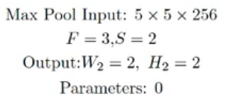




ALexNet (8 layers)

Slide 11
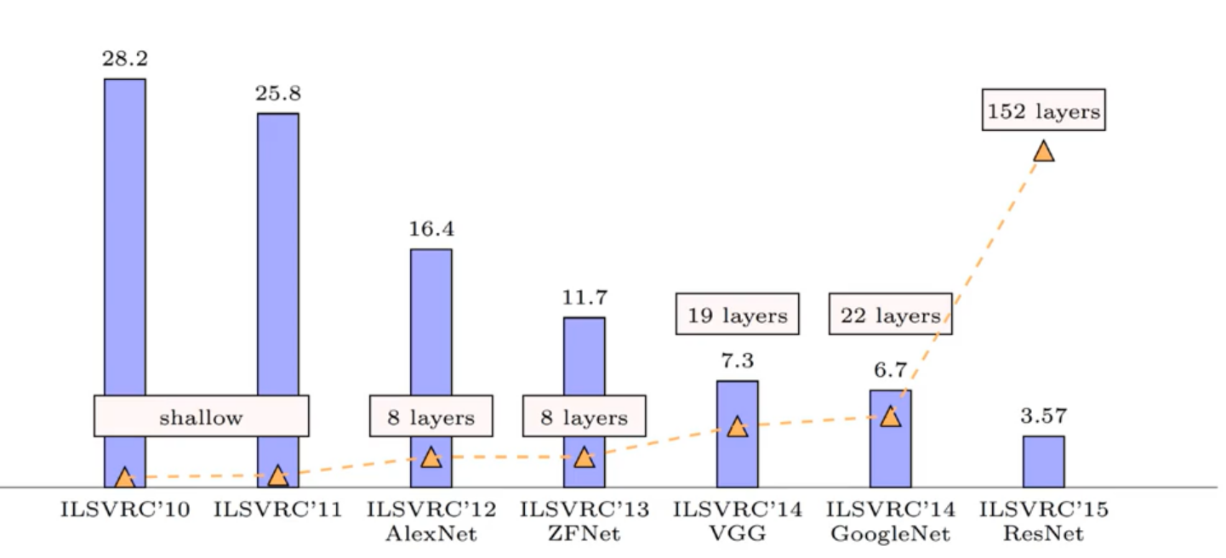
ImageNet Large Scale Visual Recognition Challenge (ILSVRC)
Error rate
https://image-net.org/challenges/LSVRC/index.php

Slide 12
Convolutional Neural Network Architectures
VGG 16

Slide 13
VGG16 (Runner-up in ImageNet 2014)
VGG16 is a convolutional neural network model proposed by K. Simonyan and A. Zisserman from the University of Oxford in the paper “Very Deep Convolutional Networks for Large-Scale Image Recognition” in 2015. The model achieves 92.7% top-5 test accuracy in ImageNet, which is a dataset of over 14 million images belonging to 1000 classes. It was one of the famous model submitted to ILSVRC-2014. It makes the improvement over AlexNet by replacing large kernel-sized filters (11 and 5 in the first and second convolutional layer, respectively) with multiple 3×3 kernel-sized filters one after another. VGG16 was trained for weeks and was using NVIDIA Titan Black GPU’s.
The authors give the intuition behind this that having two consecutive 3x3 filters gives an effective receptive field of 5x5, and 3 – 3x3 filters give a receptive field of 7x7 filters,but using this we can use a far less number of parameters to be trained in the network.
https://arxiv.org/pdf/1409.1556v4.pdf
Source paper

Slide 14
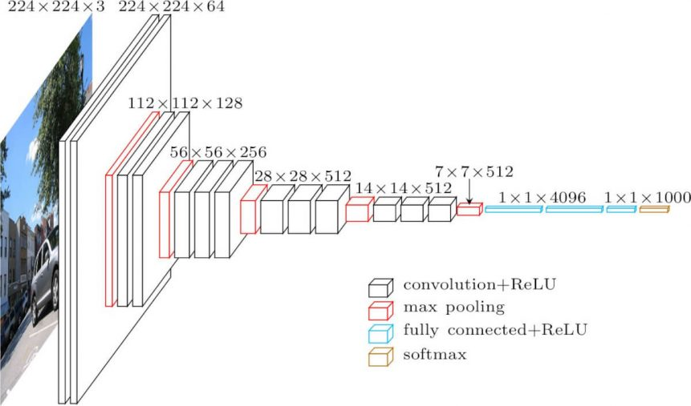

Slide 15
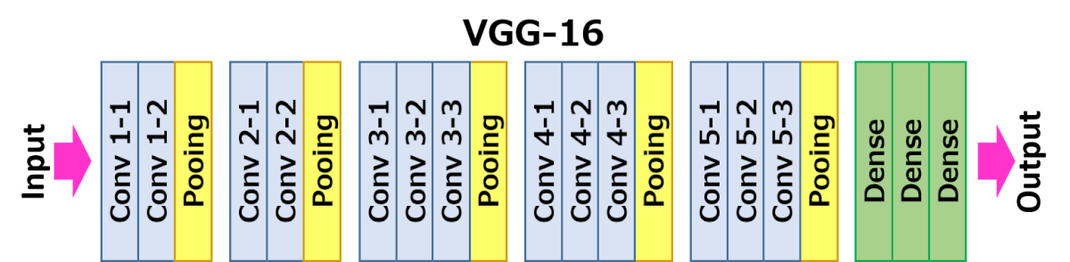

Slide 16
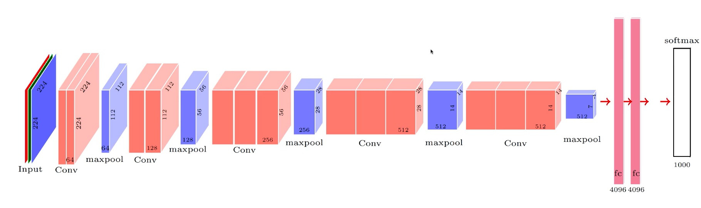
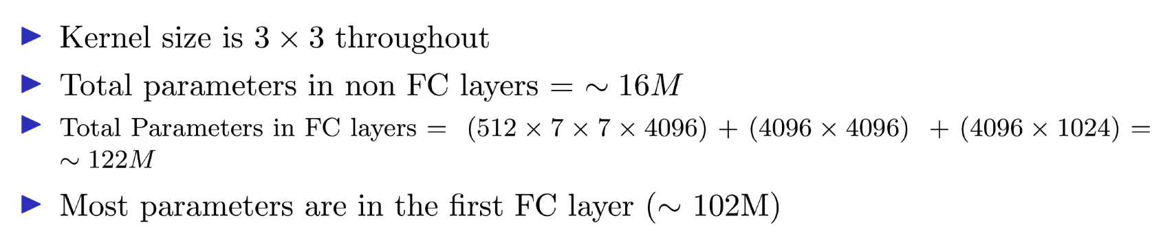
VGG-16

Slide 17
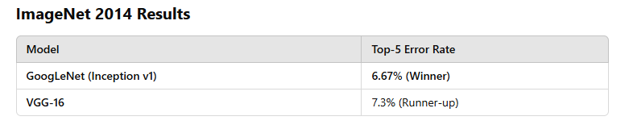
GoogLeNet

Slide 18
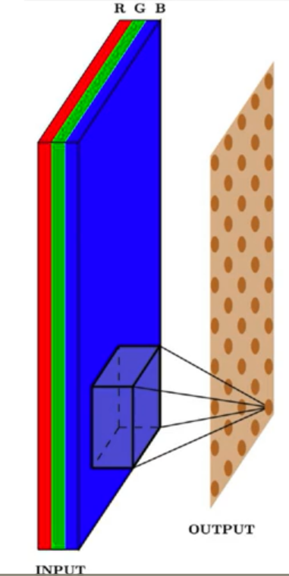
No: of computations in CNN

Slide 19
No: of computations in CNN
Assume S=1, and with appropriate padding WI=Wo=W and HI=Ho=H
Each pixel takes FxFxD computations
There are Wo x Ho such pixels
So total computations WoxHoXFxFxD
Note that computation depends on D the depth ( Intermediate layers may have bigger depth as no of filters)

Slide 20
Why Was GoogLeNet Developed?
Before GoogLeNet, deep networks like AlexNet and VGG suffered from:
High computational cost (VGG-16 had 138 million parameters).
Overfitting and vanishing gradient issues in deeper architectures.
GoogLeNet solved these issues by introducing:
✔ Inception modules (multi-scale convolutions). ✔ 1×1 convolutions (to reduce parameters). ✔ Deeper but more efficient architecture (only ~5 million parameters, compared to 138M in VGG-16).

Slide 21
GoogLeNet - Intuitions
Choice of filters- Parallel Convolutions and Max-pooling
Reduce the number of parameters- Average pooling
Reduce the computations – 1x1 Convolutions
Deeper Networks

Slide 22
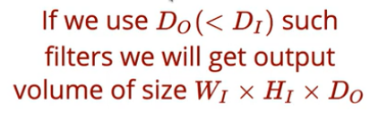
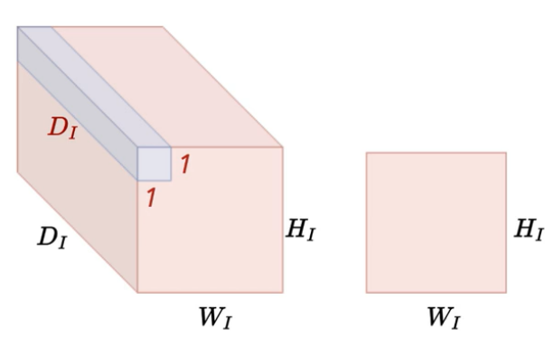
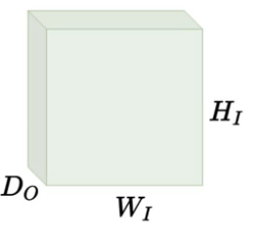
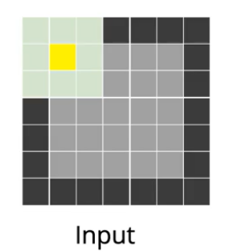
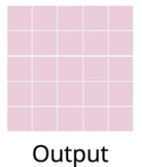
1x1 Convolution
Intuitions behind GoogleNet
( Filter of size 1x1)
It is computationally intensive to use many filters K which increases the depth (D1) of output. 1x1 convolution which basically does weighted average helps in shrinking the volume from DI to Do(Do<D1) but at retaining the values to some extend. So this intermediate step helps in reducing the complexity by shrinking the intermediate inputs ( Do kernels used)
Maxpooling with S=1,F=3,P=1
When we do maxpooling with S=1 and P=1 when F=3 we get an output of same size.
Similarly S=1,P=2 when F=5
So a stride of 1 and appropriate padding help us in retaining size of output.

Slide 23
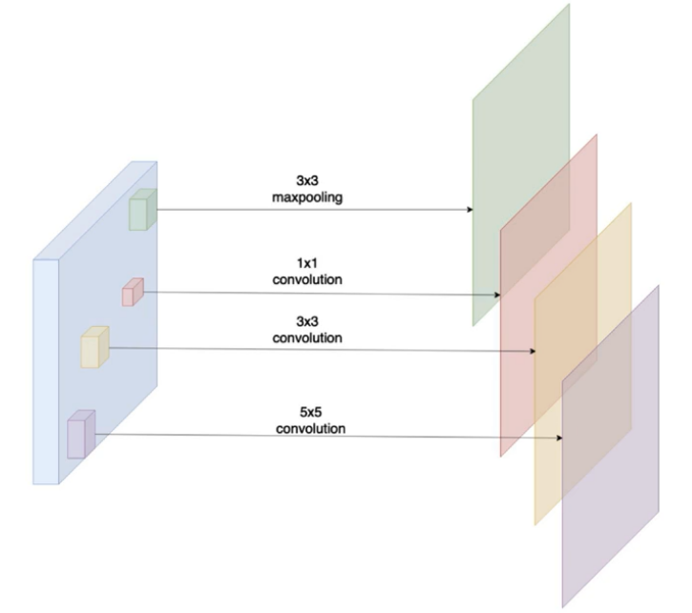
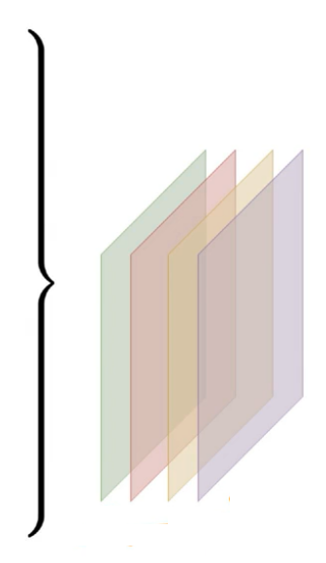
Intuition Behind GoogLeNet
Apply Stride =1 and appropriate padding to retain same output size as input
w1
h1
D0
Until now, in the architectures we had seen variations in the hyper parameters .
How many filters to use and what should be filter size?
What should be arrangement of max-pooling and convolutional layers?
How many max pooling how many convolutional layers?
Intuition behind GoogLeNet- Why to make that decision . Do everything on the same input and get a set of feature map outputs in one go- Inception Module
D1 featuremaps
D2
D3
D0+D1+D2+D3
When we have back to back convolutions, filter size can be smaller(5x5 or 3x3)

Slide 24
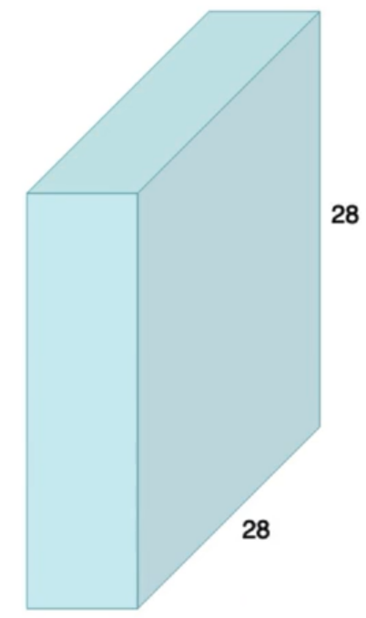
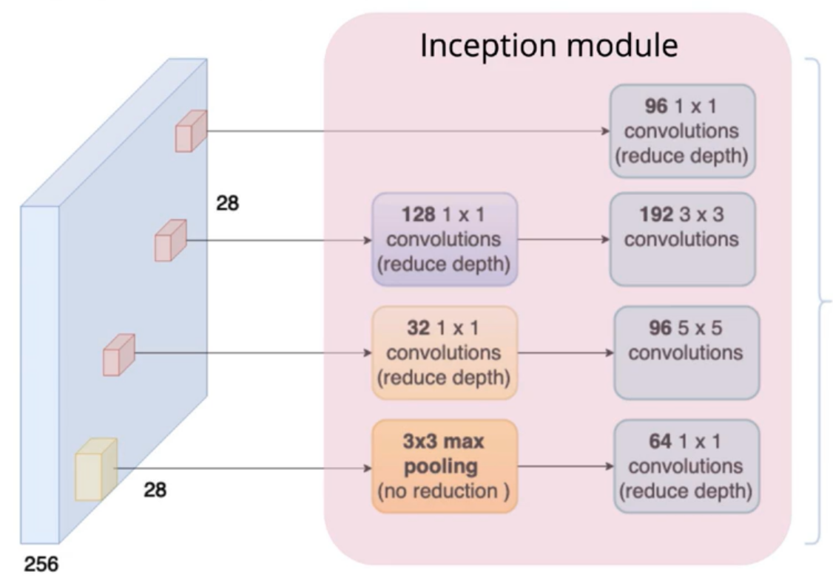
Inception Module in GoogLeNet
Apply Stride =1 and appropriate padding to retain same output size as input
96x28x28
128x28x28
192x28x28
reduction
32x28x28
96x28x28
reduction
64x28x28
256x28x28
S=1,P=1
reduction
448
96+192+96+64=448

Slide 25
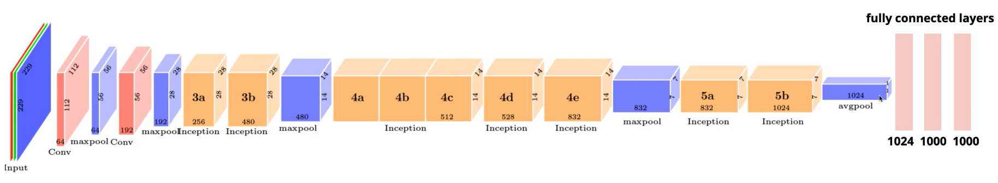
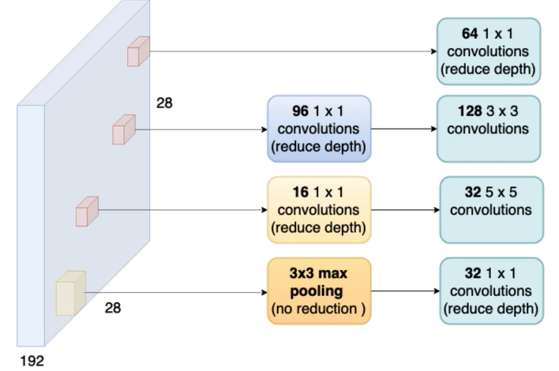
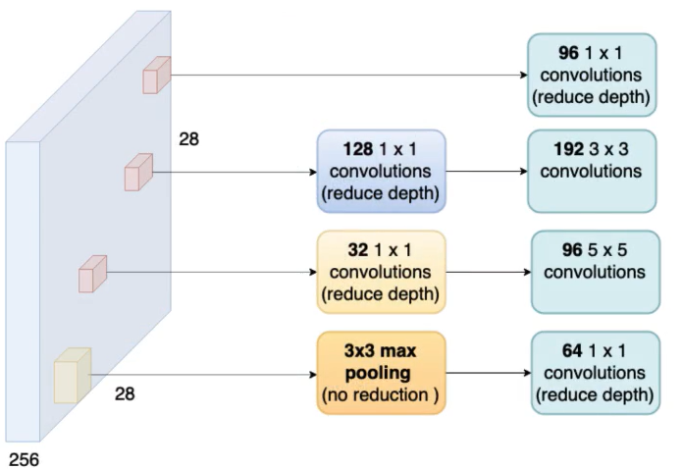
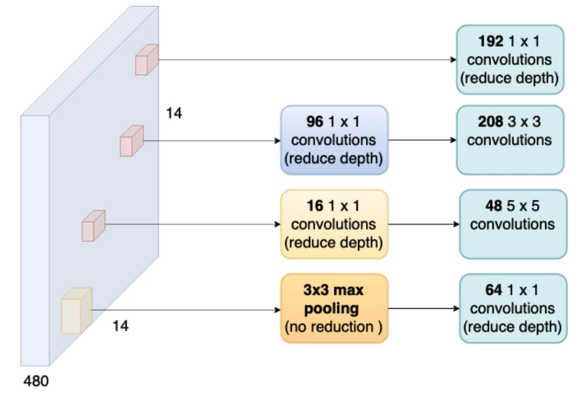
GoogLeNet Architecture
Inception I
Inception II
Inception III
Inception I
Inception II
Inception III
480x28x28
64+128+32+32=256
256x28x28
96+192+96+64=480
192+208+48+64=512
512x28x28

Slide 26
GoogLeNet Architecture- Average Pooling, Auxiliary Loss for training
backpropagation
y
Fully connected layer
y
Fully connected layer
Average pooling
backpropagation
Auxiliary Loss for training
7
The auxiliary loss will add extra gradient flow during backpropogation, thereby helping to reduce gradient vanishing problem, training stability
7
1024
Calculate average of 7x7 2D image and do it depthwise resulting in a 1D vector of 1024

Slide 27
Conclusion
Choice of filters- Parallel Convolutions and Max-pooling
Reduce the number of parameters- Average pooling
Reduce the computations – 1x1 Convolutions
Deeper Networks

Slide 28
Convolutional Neural Network Architectures
ResNet
— Winner of ILSVRC 2015 (Image Classification, Localization, Detection)

Slide 29
ImageNet Large Scale Visual Recognition Challenge (ILSVRC)
Error rate
https://image-net.org/challenges/LSVRC/index.php

Slide 30
ResNet
ResNet introduces skip connection (or shortcut connection) to fit the input from the previous layer to the next layer without any modification of the input. Skip connection enables to have deeper network and finally ResNet becomes the Winner of ILSVRC 2015 in image classification, detection, and localization, as well as Winner of MS COCO 2015 detection, and segmentation. This is a 2016 CVPR paper with 266713 citations as of 13 March 2025.
ImageNet, is a dataset of over 15 millions labeled high-resolution images with around 22,000 categories. ILSVRC uses a subset of ImageNet of around 1000 images in each of 1000 categories. In all, there are roughly 1.2 million training images, 50,000 validation images and 100,000 testing images.
ResNet was designed by Kaiming He in 2015 in a paper titled Deep Residual Learning for Image Recognition

Slide 31
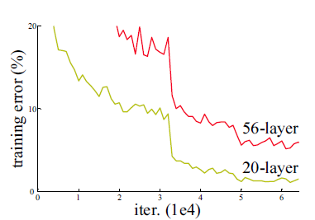
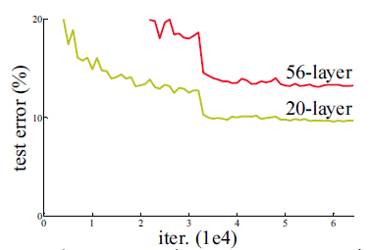
Background-Problems of Plain Network
For conventional deep learning networks ( Plain Network), having conv layers then fully connected (FC) layers for classification task like AlexNet, ZFNet and VGGNet,
When the plain network is deeper (layers are increased), the problem of vanishing/exploding gradients occurs.
Vanishing/exploding gradients
During backpropagation, when partial derivative of the error function with respect to the current weight in each iteration of training, this has the effect of multiplying n of these small / large numbers to compute gradients of the “front” layers in an n-layer network
When the network is deep, and multiplying n of these small numbers will become zero (vanished).
When the network is deep, and multiplying n of these large numbers will become too large (exploded).
We expect deeper network will have more accurate prediction. However, above shows an example, 20-layer plain network got lower training error and test error than 56-layer plain network, a degradation problem occurs due to vanishing gradients.

Slide 32
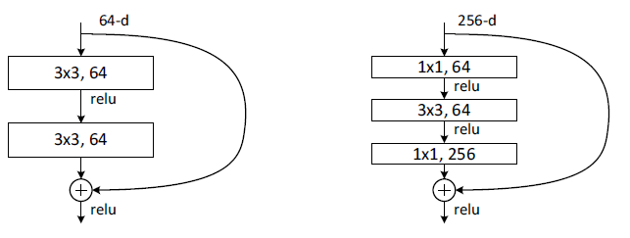
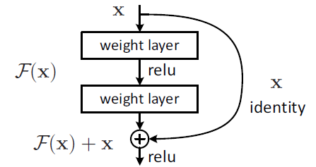
Skip / Shortcut Connection in Residual Network (ResNet)
To solve the problem of vanishing/exploding gradients, a skip / shortcut connection is added to add the input x to the output after few weight layers as below:
Bottleneck Design
A Building Block of Residual Network
The 1×1 conv layers are added to the start and end of network as in the figure (right). This is a technique suggested in Network In Network and GoogLeNet (Inception-v1). It turns out that 1×1 conv can reduce the number of connections (parameters) while not degrading the performance of the network so much
Hence, the output H(x)= F(x) + x. The weight layers actually is to learn a kind of residual mapping: F(x)=H(x)-x.
Even if there is vanishing gradient for the weight layers, we always still have the identity x to transfer back to earlier layers.

Slide 33
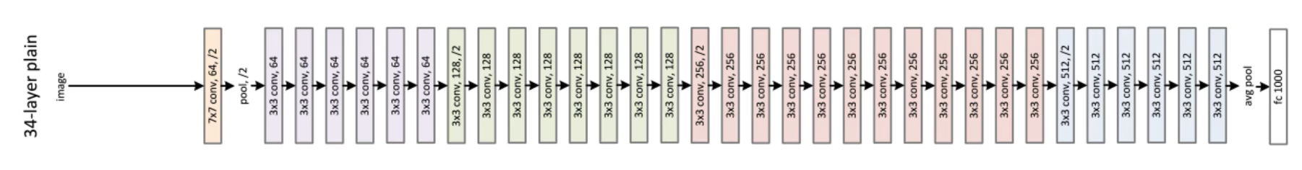
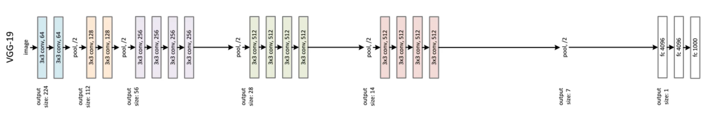
Towards ResNet Architecture
VGG -19 was added with more convolutional layers making it 34 layer, expecting better performance(being deeper) which it did not give as expected :-( . What went wrong??

Slide 34
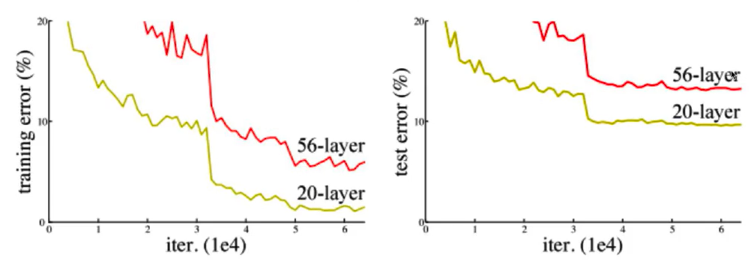
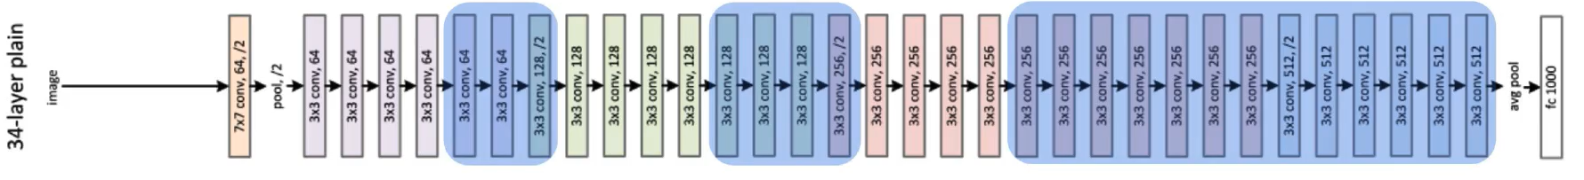
Towards ResNet Architecture
When network grows deeper input is getting transformed significantly and by the time it reaches the last layer, it is messing up the input due to many transformations

Slide 35
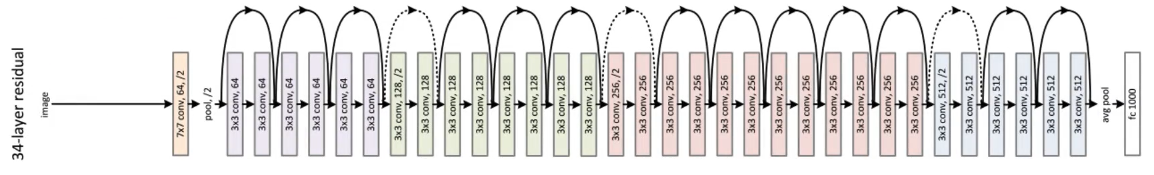
ResNet Architecture
34-layer residual network (ResNet) (top) is the plain one with addition of skip / shortcut connection.
34-layer plain network (middle) is treated as the deeper network of VGG-19, i.e. more conv layers.
The VGG-19 (bottom) is a state-of-the-art approach in ILSVRC 2014.

Slide 36
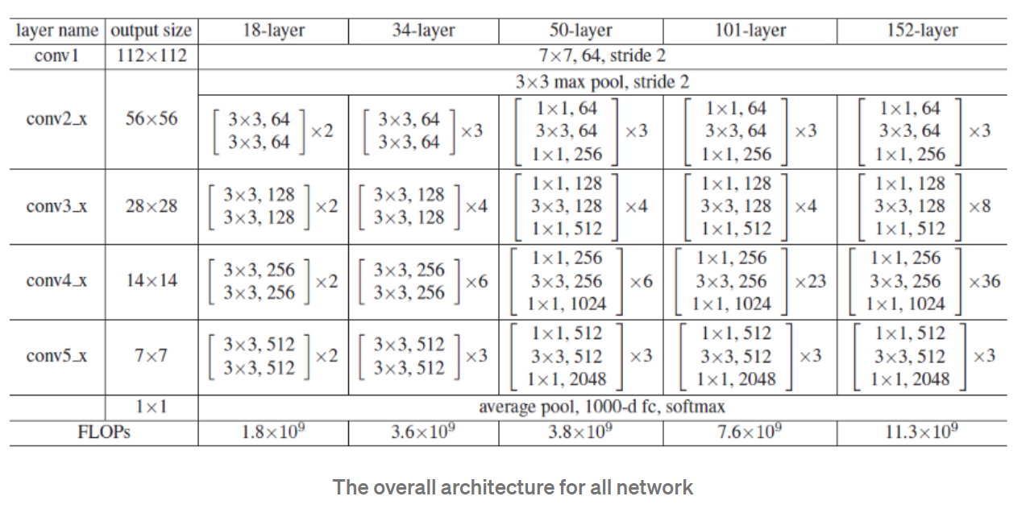
With the bottleneck design, 34-layer ResNet become 50-layer ResNet. And there are deeper network with the bottleneck design: ResNet-101 and ResNet-152.
It is noted that VGG-16/19 has 15.3/19.6 billion FLOPS. ResNet-152 still has lower complexity than VGG-16/19!!!!

Slide 37
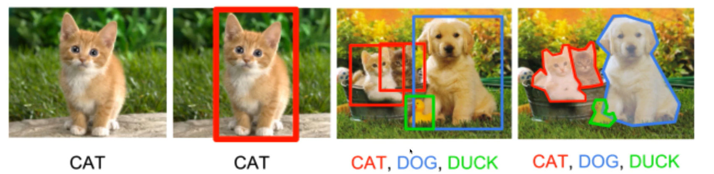
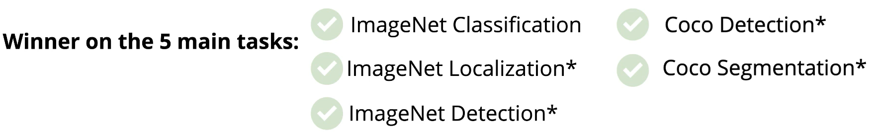
ResNet (Residual Network)– How does it perform across tasks

Slide 38
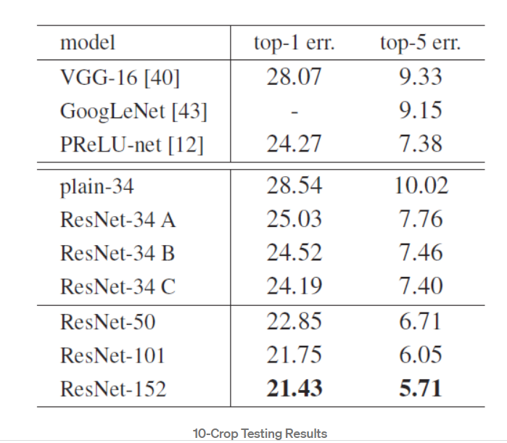
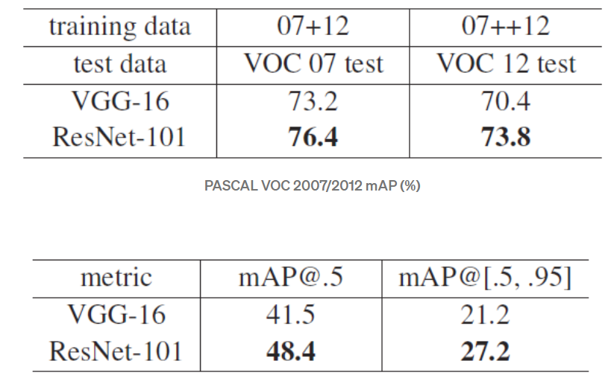
Comparison with State-of-the-art Approaches (Object Detection) ILSVRC
Comparison with State-of-the-art Approaches (Image Classification) ILSVRC

Slide 39


Slide 40

Image Classification

Slide 41

Image Classification with localization

Slide 42

Multiple Object detection
Now we have better solutions- pretrained models for object detection- YOLO, R-CNN Faster RCNN, MaskRCNN. We will see those later

Slide 43
Transfer Learning Pre-trained models

Slide 44
Transfer Learning
In practice, very few people train an entire Convolutional Network from scratch (with random initialization), because it is relatively rare to have a dataset of sufficient size. Instead, it is common to pretrain a ConvNet on a very large dataset (e.g. ImageNet, which contains 1.2 million images with 1000 categories), and then use the ConvNet either as an initialization or a fixed feature extractor for the task of interest.
These two major transfer learning scenarios look as follows:
Finetuning the convnet: Instead of random initialization, we initialize the network with a pretrained network, like the one that is trained on imagenet 1000 dataset. Rest of the training looks as usual.
ConvNet as fixed feature extractor: Here, we will freeze the weights for all of the network except that of the final fully connected layer. This last fully connected layer is replaced with a new one with random weights and only this layer is trained.
https://pytorch.org/tutorials/beginner/transfer_learning_tutorial.html

Slide 45

Transfer Learning
Following is the general outline for transfer learning for object recognition:
Load in a pre-trained CNN model trained on a large dataset
Freeze parameters (weights) in model’s lower convolutional layers
Add custom classifier with several layers of trainable parameters to model
Train classifier layers on training data available for task
Fine-tune hyperparameters and unfreeze more layers as needed
https://cloud.google.com/ai-hub/docs/introduction
Google’s Ai Hub
https://modelzoo.co/
ModelZoo curates and provides a platform for deep learning researchers to easily find code and pre- trained models for a variety of platforms and uses.

Slide 46


Existing models: How to use in Pytorch
Loading a pre-trained model
You can also load pre-trained models. In torchvision.models, all pre-trained models are pre- trained on ImageNet, meaning that their parameters have been optimized to perform well on the ImageNet 1000-class natural image classification task.
Loading a model with random parameters
You can construct a model with randomly-
initialized parameters by calling its constructor:
https://pytorch.org/vision/stable/models.html

Slide 47


Receptive Fields
Layer 3 centre pixel is influenced by 3x3 shaded area in previous layer which is inturn influenced by 5x5 and then 7x7 area of previous layer
Check what is causing a neuron to fire??

Slide 48



Visualizing filters
H14 will be high when cos θ high, ie cos θ is 1 ie θ=0
ie w and x is aligned in same direction wherever there is a match of filter pattern and image it fires and gives high response

Slide 49

Visualizing AlexNet Filters

Slide 50

Visualization in CNN-
Fig 1
Fig 2
Fig 3
Which patch in the image contribute maximally to output
Heat Map shows the difference in the output y cap of original and after masking certain portions
Fig 1: the face portion of Dog when masked resulted in substantial reduction in prediction
Fig2: The wheel is maximally contributing
Fig 3: The dog is maximally contributing. But lady also to small extend which is not right. May be all training sample had somebody holding the dog

